Slide 1
DESIGN PATTERNS
Curs OOP 12 mai 2015

Slide 2
Contents:
What does the term Design Pattern stand for?
Why should we study design patterns?
List of design patterns and categories
Presented patterns:
Singleton
Builder
Factory and Abstract Factory
Adapter
Iterator
Observer

Slide 3
Design Patterns
What are those?
First time the term of Design pattern was introduced by Christopher Alexander.
Acording to him, a pattern:
Describes a recurring problem
Describes the core of a solution
Is capable of generating many distinct designs

Slide 4
“Gang of Four” Pattern Structure
Gang of Four (GoF): Gamma, Johnson, Helm, Vlissides
Authors of the popular “Design Patterns” book
A pattern has a name
e.g., the Singleton pattern
A pattern documents a recurring problem
e.g., Issuing requests to objects without knowing in advance what’s to be requested or of what object

Slide 5
“Gang of Four” Pattern Structure
A pattern describes the core of a solution
e.g., class roles, relationships, and interactions
Important: this is different than describing a design
A pattern considers consequences of its use
Trade-offs, unresolved forces, other patterns to use

Slide 6
Why study Design Patterns?
reuse solutions that have worked in the past; why waste time reinventing the wheel?
shared vocabulary around software design
tell a software engineer “I used the X pattern”
don’t have to waste time explaining what you mean since you both know the X pattern

Slide 7
Why study Design Patterns?
Design patterns provide you not with code reuse but
with experience reuse
Knowing concepts such as abstraction, inheritance
and polymorphism will NOT make you a good designer, unless you use those concepts to create flexible designs that are maintainable and that can cope with change
Design patterns can show you how to apply those
concepts to achieve those goals

Slide 8
Design Pattern Categories
Creational patterns
Structural patterns
Behavioral patterns
Concurrency patterns

Slide 9
Creational patterns
Deal with object creation mechanisms, trying to create objects in a manner suitable to the situation by somehow controlling this object creation.
Two dominant ideas:
encapsulating knowledge about which classes the system uses.
hiding how instances of these classes are created and combined.
Further categorized into Object-creational patterns and Class-creational patterns, where Object-creational patterns deal with Object creation and Class-creational patterns deal with Class-instantiation.

Slide 10
Structural patterns
Ease the design by identifying a simple way to realize relationships between entities
Behavioral patterns
Identify common communication patterns between objects and realize these patterns. By doing so, these patterns increase flexibility in carrying out this communication

Slide 11
Singleton
Problem : Want to ensure a single instance of a class, shared
throughout a program
Context : Need to address initialization versus usage ordering
Solution :
Provide a global access method (static in C++)
First use of the access method instantiates the class
Constructors for instance can be made private(actually must C++)
Consequences :
Object is never created if it’s never used
Object is shared efficiently among all uses

Slide 12
Singleton
template <class T> class Singleton {
public:
static T *instance();
private:
Singleton();
static T *instance_;
};
// Initialize the static instance pointer
template <class T>
T *Singleton::instance_ = 0;
// Global access point
template <class T>
T *Singleton::instance() {
// check for existing instance
if (Singleton<T>::instance_ == 0) {
// may want a try/catch here
Singleton<T>::instance_ =
new Singleton<T>;
}
return Singleton<T>::instance_;
};

Slide 13
Singleton
Parameterized by a concrete type
Notice constructor and variable are private
Initialization of static s_instance variable
Outside class declaration
Outside method definition
Done before any method in compilation unit is called
Instance accessor method can then check
For a 0 instance pointer
And create a new instance if so
Same object is always returned by accessor

Slide 14
Singleton
Foo *f1 = Singleton<Foo>::instance();
Foo *f2 = Singleton<Foo>::instance();
//SAME OBJECT for both f1 and f2
Need a single instance
E.g., a common buffer of text tokens from a file
Shared across multiple points in the code
Need to share buffer
Copying is wasteful
Need to refer to same object instance
What about deleting these instances?

Slide 15
Builder
Intent:
Separate the construction of a complex object from its representation so that the same construction process can create different representations.
Parse a complex representation, create one of several targets.

Slide 16
Builder
Example:
This pattern is used by fast food restaurants to construct children's meals. Children's meals typically consist of a main item, a side item, a drink, and a toy (e.g., a hamburger, fries, Coke, and toy dinosaur). Note that there can be variation in the content of the children's meal, but the construction process is the same.

Slide 17
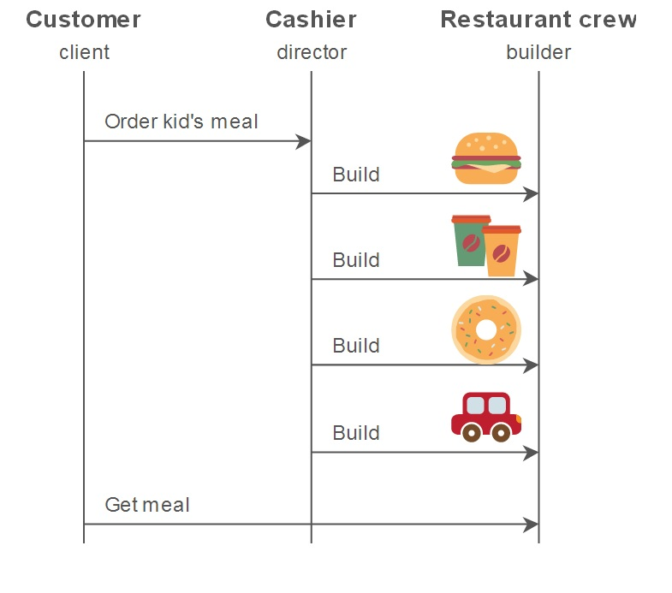
Builder
Example:

Slide 18
Builder
Example:
Whether a customer orders a hamburger, cheeseburger, or chicken, the process is the same. The employee at the counter directs the crew to assemble a main item, side item, and toy. These items are then placed in a bag. The drink is placed in a cup and remains outside of the bag. This same process is used at competing restaurants.

Slide 19
Builder
How to use a builder?
Decide if a common input and many possible representations (or outputs) is the problem at hand.
Encapsulate the parsing of the common input in a Reader class.
Design a standard protocol for creating all possible output representations. Capture the steps of this protocol in a Builder interface.

Slide 20
Builder
How to use a builder?
Define a Builder derived class for each target representation.
The client creates a Reader object and a Builder object, and registers the latter with the former.
The client asks the Reader to "construct".
The client asks the Builder to return the result.

Slide 21
Builder
Code:
http://en.wikibooks.org/wiki/C%2B%2B_Programming/Code/Design_Patterns/Creational_Patterns

Slide 22
(Abstract) Factory
Factory:
A utility class that creates an instance of a class from a family of derived classes
Abstract Factory:
A utility class that creates an instance of several families of classes. It can also return a factory for a certain group.

Slide 23
(Abstract) Factory
Intent:
Provide an interface for creating families of related or dependent objects without specifying their concrete classes

Slide 24
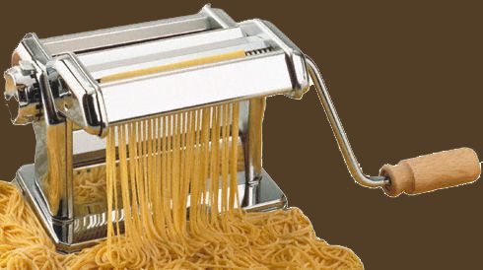
(Abstract) Factory
Example: pasta maker
The code is the pasta maker .Different disks create different pasta shapes . These are the factories.
All disks have certain properties in common so that they will work with the pasta maker.
All pastas have certain characteristics in common that are inherited from the generic “Pasta” object.

Slide 25
(Abstract) Factory
Code:
http://en.wikibooks.org/wiki/C%2B%2B_Programming/Code/Design_Patterns/Creational_Patterns#Factory

Slide 26
Adapter
Problem :
Have an object with an interface that’s close to but not exactly what we need.
What do we do?
Context:
Want to re-use an existing class
Can’t change its interface
Impractical to extend class hierarchy more generally

Slide 27
Adapter
Solution:
Wrap a particular class or object with the interface needed (2 forms: class form and object forms)
Consequences:
Implementation you’re given gets the interface you want

Slide 28
Iterator
Intent:
Want to access aggregated elements sequentially, like traverse a list of names and print them out.
Don’t want to know details of how they’re stored, in a linked list, or an array, or a balanced binary tree
Solution core:
Provide a separate interface for iteration over each container

Slide 29
Iterator
Consequences:
Frees user from knowing details of how elements are stored
Decouples containers from algorithms (crucial in C++ STL)
Examples:
C++ pointers, C++ STL list<int>::iterator

Slide 30
Iterator
Specifications:
Each container may have a different iterator type
Iterator knows the internals of the container
Object-oriented form shown below (for user-defined types)
Slightly different with built-in types, templates
E.g., no inheritance relationship, may use traits, etc.

Slide 31
Iterator
Implementation:
Object-oriented version of iterator is natural to implement as a class in C++.
Constructor stores passed pointer to C-style string s, positions current_ at s (string),
first (re)positions iterator at the start of the string
next moves iterator to the next position
is_done iterating whether iterator is at the end of the string
current_item returns a pointer to the character at the current iterator position

Slide 32
Iterator
Code:
class StringIterator {
public:
StringIterator (char * s)
: s_ (s), current_ (s) {}
void first () {
current_ = s_;
}
void next () {
++current_;
}
bool is_done () {
return *current_ == 0;
}
char * current_item () {
return current_;
}
private:
char *s_;
char *current_;
};

Slide 33
Iterator
unsigned int letter_count
(StringIterator& si, char c)
{
unsigned int count = 0;
for (si.first ();
! si.is_done ( );
si.next ())
if (*si.current_item () == c)
++count;
return count;
}
Iterators naturally support use in looping constructs
first is used to initialize
is_done used for loop test
next used to increment
current_item is used in loop comparison
Usually stl data structures have an “end()” function. We should compare iterator to that
loop completes => function shown has
Iterated through entire string
Counted occurrences of the character value in the string
Returned the occurrence count

Slide 34
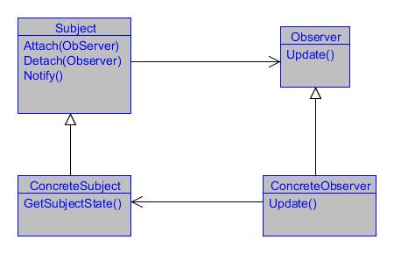
Observer
The Observer Pattern defines a one-to-many dependency between objects so that when one object changes state, all its dependents are notified and updated automatically.
one part of our application updated with the status of some other part of the application.
class diagram for Observer Pattern(Reference: GoF Design Patterns)

Slide 35
Observer
Subject:
keeps track of all the observers
provides the facility to add or remove the observers.
responsible for updating the observers when any change occurs
ConcreteSubject:
the real class that implements the Subject.
is the entity whose change will affect other objects.
Observer:
an interface that defines the method that should be called whenever there is any change
ConcreteObserver:
needs to keep itself updated with the change.
needs to implement the Observer
register itself with the ConcreteSubject and it is all set to receive the updates.

